Slide 1

Inventory Integrity: From Friction to Precision
Presenter: Julian Low (u3335040)
Notes:
Slide 1: Hi everyone and welcome to the third part of the PPIT Assessment 1. Which is the sales pitch, I am Julian and will be presenting today and we will be discussing a case study regarding inventory and logistics, and the socio-technical problem inherent and the solutions that to be applied.

Slide 2
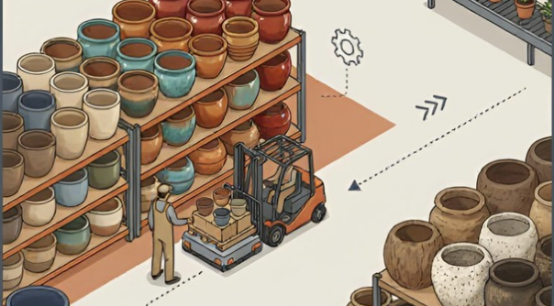
Notes:
Slide 2: So before we get into it, just a look at this picture just to get an idea of the client we will be discussing

Slide 3

THE Story so far...
Client Profile: Landscape Design firm based in Sydney that has recently launched it’s own pot & planter range
Manual Warehouse Processes and fragmented systems are negatively affecting a design firm’s product range launch
Fragmented data creates "Ghost Stock" discrepancies
Eroding customer trust and placing immense social burden on staff to bridge systemic gaps
"Friction Tax" (employee time wasted on reworks / mistakes etc) estimated at $20K / month
Notes:
Slide 3: So as you know from the previous 2 assessments, the client is a design firm that has launched it’s own product range of garden pots it’s but its warehouse processes are largely manual and the stock counts aren't really flowing through properly to the other departments like Finance and Accounting, Sales etc because they've got to manually enter the warehouse stock figures into their own systems. For example, imagine the accounting system is seeing a certain stock value on their balance sheet, but that's actually not what's in the warehouse. Or the sales guys think a pot is available for sale but that it's actually out of stock.

Slide 4
The Human Factor
Warehouse Crew: Current staff act as the "glue" for shadow systems. System abandonment risk is high if tech burden exceeds operational speed.
Finance Department: Spends 25% of their role on reactive troubleshooting. Strategic reporting is blocked by unreliable "ghost stock" values.
Safety (Guardrail R1): No systematic way to flag planters over 20kg, leading to physical strain and non-compliance with OH&S.
Notes:
It’s a financial and social drain on the staff really (as you can see from this slide), leading to a ‘friction tax’ (if you will) of an estimated 20,000 dollars a month.

Slide 5
The Socio-TECHNICAL PROBLEM
Siloed Data
Fragmented Systems
'Patchwork' of systems prevents company forming a unified view of it's operations
Notes:
So we are dealing with the sociotechnical problem of siloed data and fragmented systems. Where we have a 'Patchwork' of systems that prevents a company forming a unified view of it's operations.

Slide 6

Sales / Design / Finance Depts
Warehouse Dept
Shadow System (spreadsheets, manual processes etc)
Notes:
I used this illustration as a representation, the two islands refer to the two separate systems used by the warehouse and the other departments, the ocean between is the20k opf friction tax caused by the spreadsheets and manual processes that aren't properly linking them, what we need is bridge between the two islands.

Slide 7
We are going with…...
Solution A: Better Manual Processes (REJECT)
Processes involving manual spreadsheets (no matter how refined) as still too risky
Solution B: Targeted Inventory Management Software Upgrade
The 'Goldilocks' Solution. Solves the socio-technical issues better (than A) of the company at a lower cost and deployment time (compared to C).
Balances technical capability with cultural adoption.
Solution C: Full ERP (Enterprise Resource Planning) Rollout (REJECT)
ERP is simply too expensive and implementation too time-consuming
Notes:
Following disussion of the three solutions in previous assessments we are going with a upgrade to an Inventory Management Software solution, solution B. Why? Because it’s more effective than Solution A but cheaper and easier to implement that Solution C. It's also a less’ drastic’ change so it balances technical capability with cultural adoption.

Slide 8
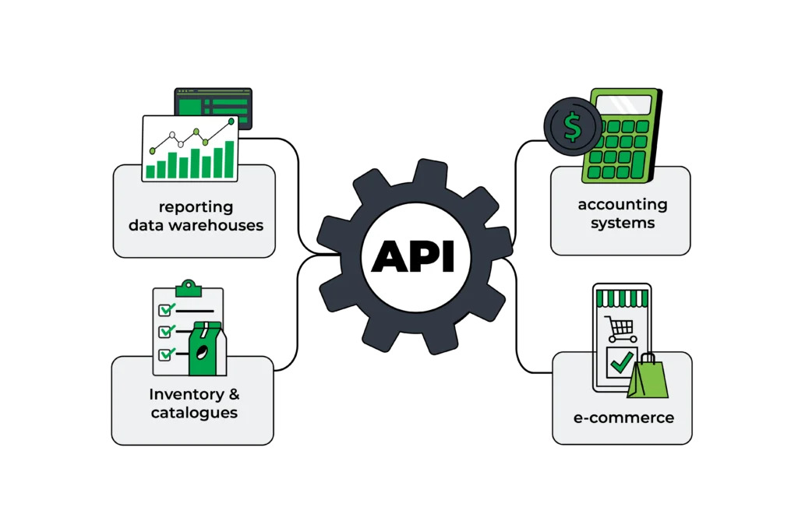
Notes:
So this is how it works the warehouse now uses an inventory software system to manage everything, and it feeds into the other systems like the accounting system and sales. What's an API? API is simply put a sort of translator that allows two different computer systems to talk to each other, without a human having to manually type anything in."

Slide 9

THE TECHNOLOGY
PROPOSAL: INTEGRATED INVENTORY HUB
Transition from manual "shadow systems" to an API-driven Single Source of Truth.
It 'talks' to the other systems (especially Accounting) via API-calls.
This isn't another silo; it’s a bridge that ensures Finance and Warehouse Ops see the same numbers.
This professionalizes our inventory management without the risk or cost of a full ERP rollout.
Notes:
Soi this means the financial and sales systems get real-time stock data from the warehouse, no manual entry involved!

Slide 10

THE TECHNOLOGY
Real-Time API Sync:
The Finance Officer (FIAN L4) manages the cloud-to-ledger connection between he Inventory and Accounting Software.
Automated: Stock updates push to sales floor instantly.
Integrated: Purchases sync directly with Chart of Accounts.
Validated: Discrepancy alerts handled by Warehouse Lead.
Notes:
With our inventory software hub acting as the single ‘source of truth’ that is how we will ensure that the sales or the accounting systems are sharing the same set of data, to allow for greater accuracy. So everybody is seeing the same numbers.

Slide 11
GUARDRAILS
R1: Do not manually lift heavy objects over 25kg
Our safety-first stance utilises system metadata to stop accidents before they happen. Mandatory alerts trigger for any item exceeding 20kg.
R2: Protect customer’s personal information
Need to know data-masking protects client Personally Identifiable Information (PII) from unauthorized view
R3: Ethical Supplier Enforcement
Payment blockages for offshore suppliers missing valid labor certifications
Notes:
I will quickly go through the guardrails we discussed in the previous assessments are also still enforced in this new system, you've got R1 which is heavy object safety, we can print labels that flag the stock.
R2, which is protecting customer privacy, we can mask their personal info. Lastly, we have enforcing a supplier's ethical credentials, we can do that by denying purchase orders for those who don't supply ethical labor certifications.

Slide 12
SYSTEM OWNERSHIP
WAREHOUSE LEAD: Identifies and resolves discrepancies. Owns the physical triage and scanning accuracy.
FINANCE OFFICER: Monitors API health / technical sync and ledger integrity. Interprets data for executive growth reporting. Frees Warehouse from the 'tech burden'.
EXECUTIVE: Sets investment strategy and authorizes CapEx pivots based on ROI metrics.
Notes:
I'll give you an example of how the stakeholders are involved: it's a bit like a three-man relay team. You have the warehouse lead on the ground making sure the physical inventory matches whats in the system, you have the finance officer handling the technical duties

Slide 13
DEPLOYMENT ROADMAP
Week 1-2: Discovery (API Mapping)
Week 2–4: Pilot (Live Testing)
Week 5–6: Scale (Rollout)
Notes:
Here's the 6 week roadmap broken up into 3 phases 2 weeks.

Slide 14

THE ASK.....
DEPLOYMENT ROADMAP
WEEKS 1-2: DISCOVERY
  API Mapping and Metadata Audit for Weight Classes
WEEKS 3-4: PILOT
  High volume testing with the Warehouse Lead (designated Implementation Champion)
WEEKS 5-6: SCALE
  Full firm rollout and decommissioning of spreadsheet system
FUTURE ROADMAP: Integrated data foundation for future ERP transition (Solution C).
Notes:
You've got week 1-2, the discovery phase, where finance officer will map the warehouse data to their financial ledger, the Week 2-4 Pilot phase where the warehouse manager will run high volume testing to check if the system can handle it then finally we have Week 5-6 which is when we move to the new system and decommision the old spreadsheets. By the way, remember the rejected Solution C, the full ERP rollout because it was too much of a transformation? Well we still leave the door open for that since we have a solid foundation to build on.

Slide 15
RISK AND ADAPATION
FUTURE DISRUPTION
  Demand Surge: Managed via an "Offline Buffer" protocol to maintain speed without data loss.
  AI Vision Triage: A "next-horizon" pivot from scanning hardware to automated computer vision
  Privacy Shifts: Modular API filters allow instant compliance updates.
Notes:
This is just some potential technological disruption cases we need to provision for, I'll be brief, a buffer to manage demand spikes, moving from barcode scanning to AI computer vision should the technology be more accepted, and flexible privacy filter settingsin case of a change of privacy laws.

Slide 16
Final Reflections
Key Insight & Lessons Learned: Case study was based on my previous employment, I was a Finance Officer at one such company going through this very transformation, applying the concepts learnt help me view the experience through a socio-technical lens
Feedback: Feedback was useful in terms of course-correcting while working on the blueprint throughout.
Assignment 1A: Was reminded to mention the guardrails and stakeholders and not just focus on the problem / solution
Assignment 1B: Was advised to make my assignment less technical / reduce use of jargon, imagine I was writing a report to non-technically inclined stakeholders
Notes:
Ok and just some final reflections, in case you haven't realised, this case study was based on my own professional experiences, I was a finance officer once at a company going through this same transformation so it was interesting viewing through the social-technical prism. I'm grateful for the feedback provided throughout the semester, one was to fuces on stakeholders and guardrails more, the other was reduce the technical jargon used.

Slide 17
KEY TAKEAWAY
"This 6-week roadmap isn't just a plan for software; it's a strategic transition to a more professional, ethical, and profitable operation".
Notes:
I'll just leave you with this takeaway, the 6 week roadmap presented, it's not just a new software rollout, is a transition to more professional, ethical and profitable organisation.

Slide 18
THANK YOU
Presenter: Julian Low (u3335040)

Slide 19
References
Canva AI Image Generator 2026, multiple images , AI-generated image, Canva Pty Ltd, accessed 16 May 2026.
Cropster 2026, [Cropster API Integration architecture diagram], Image, Cropster, viewed 16 May 2026, https://www.cropster.com/cropster-api-integration/.
Microsoft Designer 2026, Animated Opening Slide, AI-generated image, Microsoft Corporation, accessed 16 May 2026.
Microsoft Designer 2026, A professional 3-phase project implementation timeline in a modern tech style, AI-generated image, Microsoft Corporation, accessed 16 May 2026.

